Slide 1
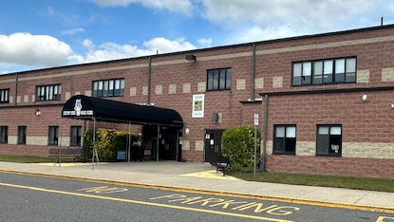
Chestnut Ridge
Middle School
2025-2026
Announcements

Slide 2

Monday, September 15, 2025
CRMS Daily Announcements

Slide 3
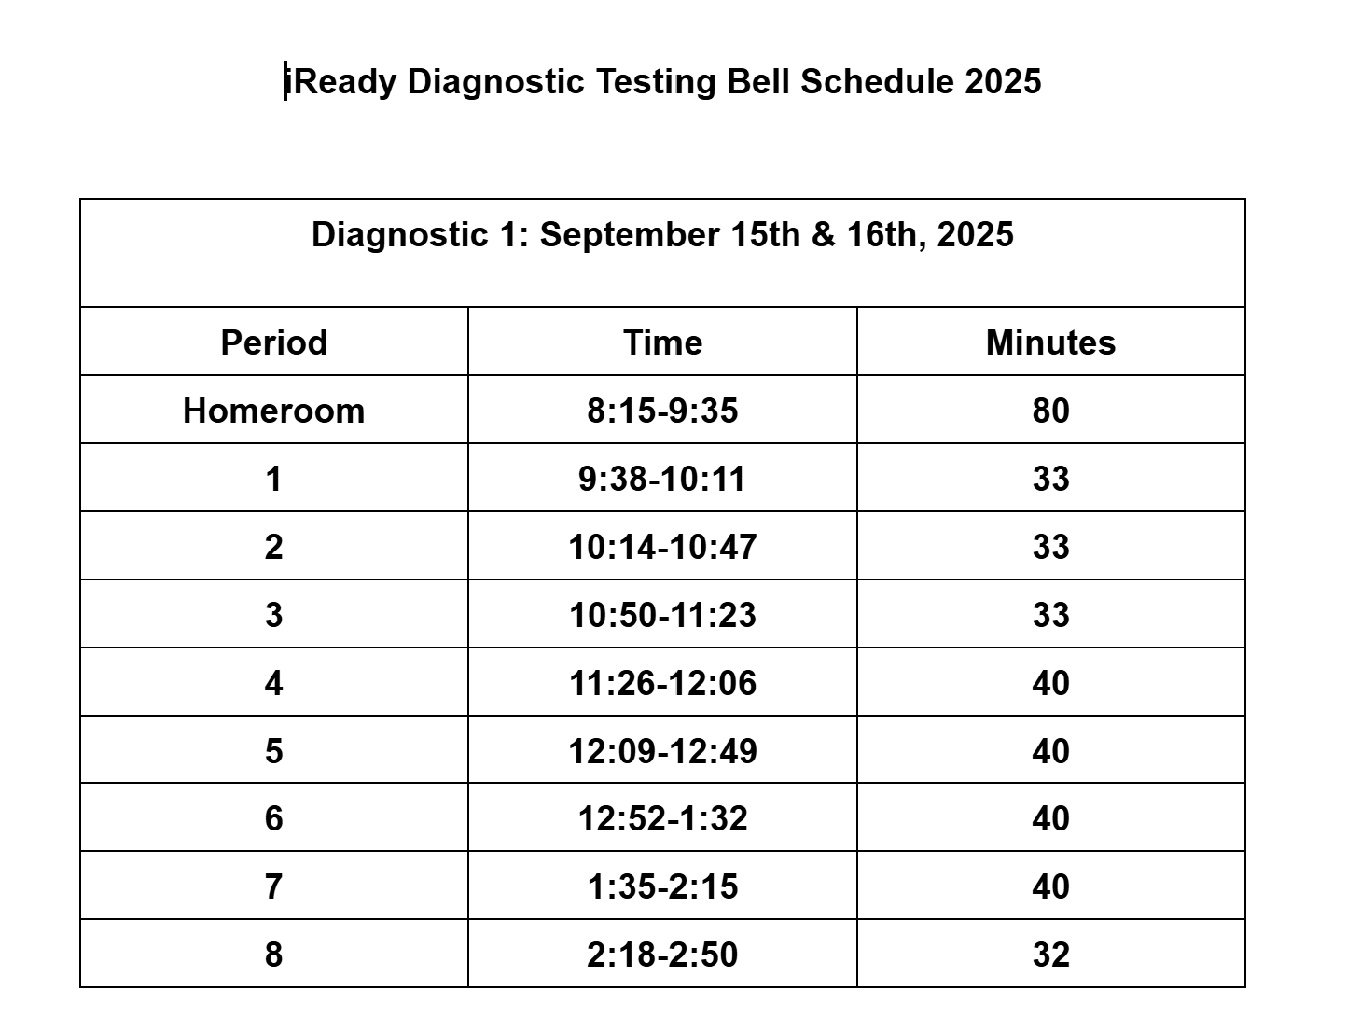


Slide 4

CRMS Dance Team
The CRMS Dance Team will meet in Room 114 on Thursday, September 18th, at 2:50 pm. Please come dressed to dance!
Sneakers are a MUST. You will NOT be allowed to dance if you are in Uggs/Crocs/or slides. Please bring water – we will be sweating!
If you have not come to Room 114 to get a permission slip and physical form, please do so BEFORE Thursday. See Ms. Mallett for any questions.

Slide 5

CRMS Yearbook Club
The CRMS Yearbook club will hold its first meeting of the year after school on Tuesday, September 16, in room 202.
All are welcome to attend.

Slide 6

6th Grade HW Club
The 6th Grade HW Club will be held on Tuesday, September 16, 2025, in RM #103 with Mrs. Johns.
All 6th Grade Students are Welcome!

Slide 7

CRMS Drama
A reminder that if you are auditioning for the Fall musical, you MUST sign up for an audition slot at the door to the left of the stage.
You MUST also sign and return the Drama Club audition Permission Form and Drama Club Code of Conduct at your audition, or you will NOT be allowed to audition.
Remember, auditions are until 5 pm, and you must be picked up at the rear of the building.

Slide 8
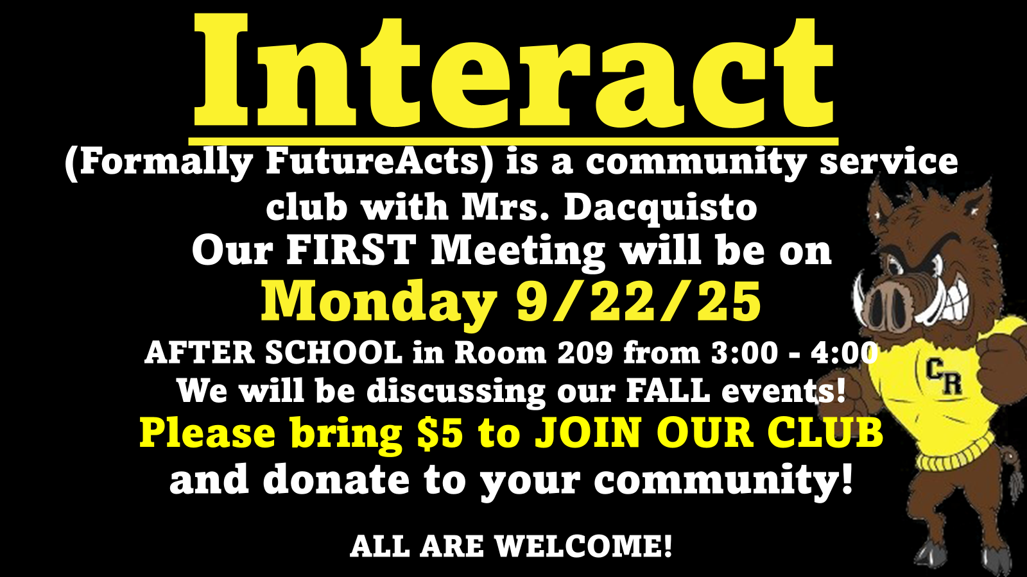

Slide 9

CRMS: 6th and 7th Grade
Class Council
The 6th and 7th grade Class Council will have their first meeting on Tuesday, September 30th, 2025, after school in Room 108.
All 6th and 7th-grade students are encouraged to attend and help plan this year's events.
Please see Mrs. Ianaole, the Grade 6 Advisor in Room 108, or Mrs. Standard, the Grade 7 Advisor in Room 220, for any questions.

Slide 10

CRMS Yearbooks
The CRMS Yearbooks for the 25-26 school year are now on sale!
The price is $35 for a limited time.
See the link on the CRMS website to order!

Slide 11

CRMS: Water Bottle Reminder
Please be sure all water bottles are spill-proof and can be sealed. ONLY water is allowed.
Thank you!

Slide 12
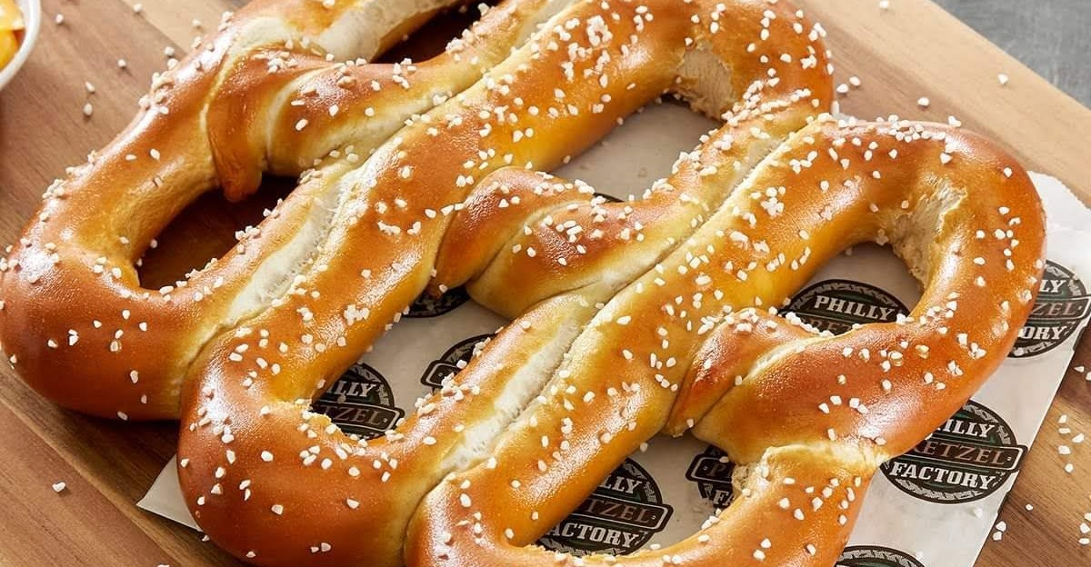
The CRMS Pretzel Sale will begin this
Friday and every Friday in Room 121.
Pretzels are $1, and mustard is available. You may purchase a pretzel during your lunch period.
CRMS Pretzel Sale

Slide 13
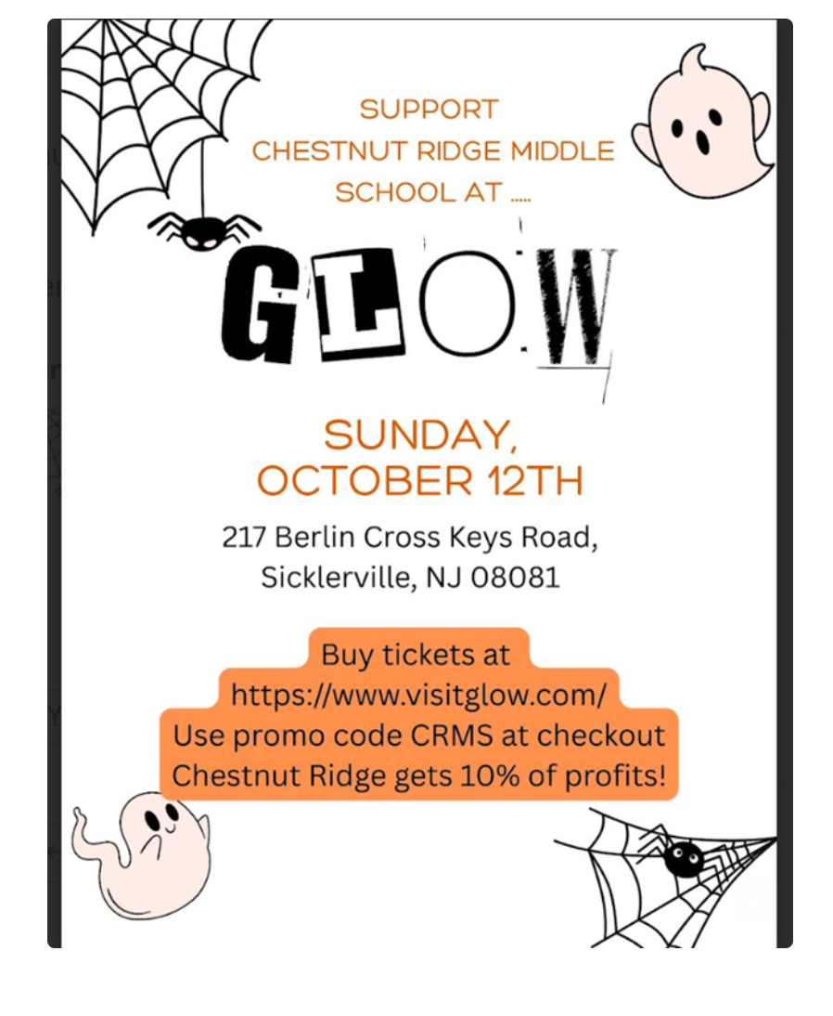

Slide 14

CRMS! Where Our Students HUSTLE Every Day!

